Slide 1
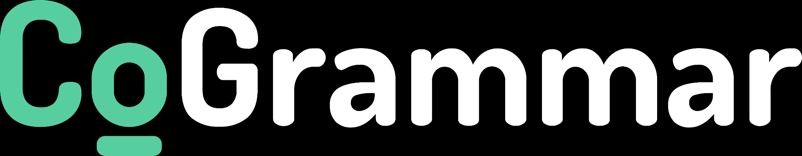
Welcome to the
Ciphers
The session will start shortly…
Questions? Drop them in the chat. We'll have dedicated moderators answering questions.

Slide 2

Cyber Security Session Housekeeping
The use of disrespectful language is prohibited in the questions, this is a supportive, learning environment for all - please engage accordingly. (Fundamental British Values: Mutual Respect and Tolerance)
No question is daft or silly - ask them!
There are Q&A sessions midway and at the end of the session, should you wish to ask any follow-up questions. Moderators are going to be answering questions as the session progresses as well.
If you have any questions outside of this lecture, or that are not answered during this lecture, please do submit these for upcoming Academic Sessions. You can submit these questions here: Questions

Slide 3
Cyber Security Session Housekeeping cont.
For all non-academic questions, please submit a query: www.hyperiondev.com/support
We would love your feedback on lectures: Feedback on Lectures
Find all the lecture content in you Lecture Backpack on GitHub.
If you are hearing impaired, please kindly use your computer's function through Google chrome to enable captions.

Slide 4
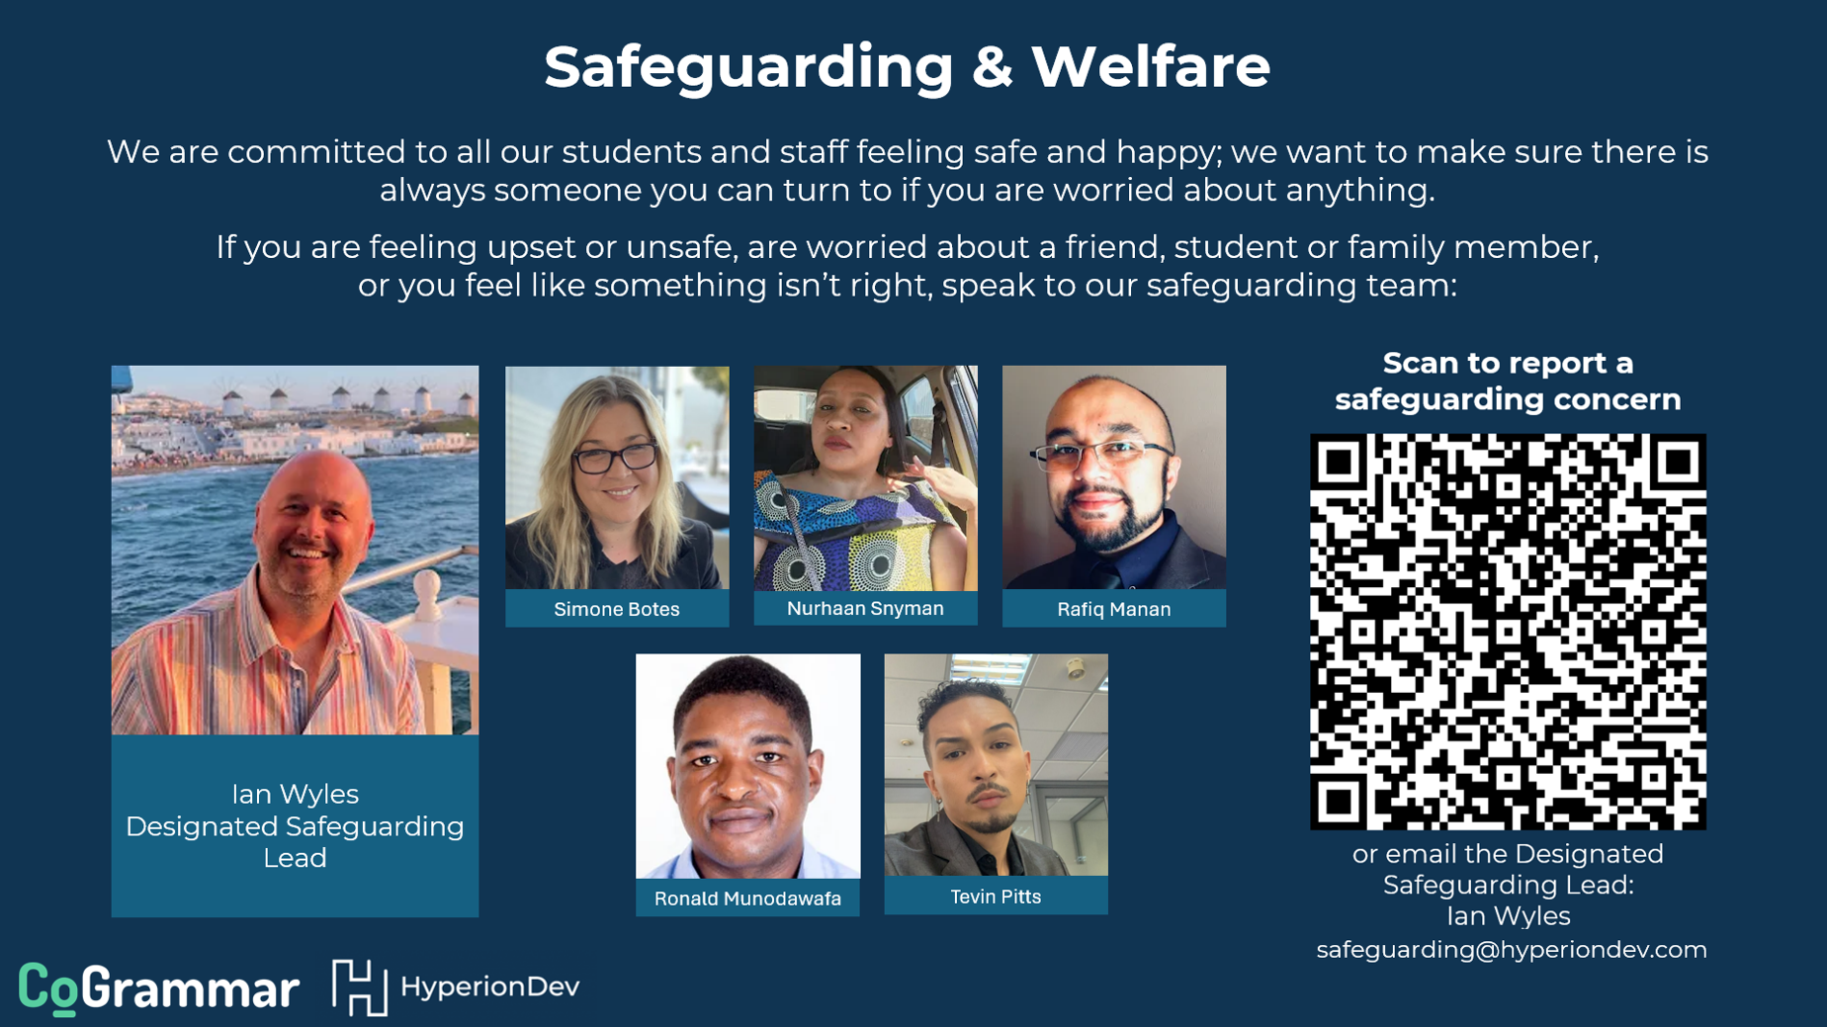

Slide 5

Stay Safe Series:
Mastering Online Safety One Week/step at a Time
While the digital world can be a wonderful place to make education and learning accessible to all, it is unfortunately also a space where harmful threats like online radicalisation, extremist propaganda, phishing scams, online blackmail and hackers can flourish.
As a component of this BootCamp the Stay Safe Series will/is designed to guide you through essential measures in order to protect yourself & your community from online dangers, whether they target your privacy, personal information or even attempt to manipulate your beliefs.
Stay Safe Series

Slide 6


Security Tip
Limit user permissions to the minimum required for their roles. By applying the principle of least privilege, you reduce the risk of unauthorized access or accidental data exposure, even if a breach occurs."
Stay Safe Series
Notes:
1. Impact on Reputation
What you post online can significantly affect your personal and professional reputation. Thoughtful consideration before sharing can prevent misunderstandings or damage to your image.
2. Permanent Record
Once something is posted online, it can be difficult to completely remove it. Even deleted posts may be archived or captured by others, so it's crucial to think carefully about the content you share.
3. Privacy Concerns
Sharing personal information can lead to privacy issues, including identity theft or unwanted attention. Being cautious can help protect your privacy.
4. Miscommunication
Online communication lacks the nuances of face-to-face interactions, which can lead to misinterpretations. Pausing before posting allows for clearer, more considerate communication.
5. Influence on Others
Your posts can influence friends, family, and followers. Thoughtful sharing can promote positive discussions and awareness, while careless posting can spread misinformation or negativity.
6. Professional Implications
Employers often review candidates' online presence. Maintaining a professional digital footprint can enhance job prospects and career development.
7. Mental Well-being
Engaging in social media can sometimes lead to stress or anxiety. Taking a moment to pause can help manage your emotional response and contribute to a healthier relationship with technology.
Summary
"Pause Before You Post" serves as a reminder to be mindful of your digital presence, ensuring that your online actions reflect your values and intentions while protecting your reputation and privacy.
–
The concept of "Pause Before You Post: Managing Your Digital Presence" can be tied to the fundamental British value of Respect and Tolerance for Others.
Connection to Respect and Tolerance:
Respect for Individuals: Considering how your posts might affect others shows respect for their feelings and opinions. It encourages thoughtful dialogue rather than impulsive reactions.
Tolerance of Diverse Views: The internet is a platform for diverse perspectives. Pausing before posting helps foster an environment where differing views are respected, promoting understanding and reducing conflict.
Empathy: Taking a moment to reflect before sharing content encourages empathy, allowing individuals to consider how their words might impact others.
By emphasizing respect and tolerance, individuals can contribute to a more positive and inclusive online environment.

Slide 7


Learning Objectives & Outcomes
Explain what ciphers are and why we use them.
Explain how caesar cipher works.
Implement a caesar cipher within Python code.
Notes:
Mention moderators and Questions tab. Our agenda includes an introduction to CoGrammar, details about student success support, graduation criteria, guided learning hours, learning tools and platforms, an overview of the Skills Bootcamp, and career services.

Slide 8


Ciphers
October 2024
Notes:
Welcome to the Grammar Skills Bootcamp Orientation for November 2023. Today, we will cover several important aspects of this program to ensure you have all the information needed for a successful learning experience.

Slide 9

Strings, Lists and Functions
Can you think of a time when information needs to be kept secret or secure?
Notes:
Mention moderators and Questions tab. Our agenda includes an introduction to CoGrammar, details about student success support, graduation criteria, guided learning hours, learning tools and platforms, an overview of the Skills Bootcamp, and career services.

Slide 10

Strings, Lists and Functions
If you had to send a secret message to a friend without using any software, how would you create a system to encode the message?
Notes:
Mention moderators and Questions tab. Our agenda includes an introduction to CoGrammar, details about student success support, graduation criteria, guided learning hours, learning tools and platforms, an overview of the Skills Bootcamp, and career services.

Slide 11

Ciphers
Method used to encrypt and decrypt data.
Used to protect sensitive data
Notes:
Mention moderators and Questions tab. Our agenda includes an introduction to CoGrammar, details about student success support, graduation criteria, guided learning hours, learning tools and platforms, an overview of the Skills Bootcamp, and career services.

Slide 12
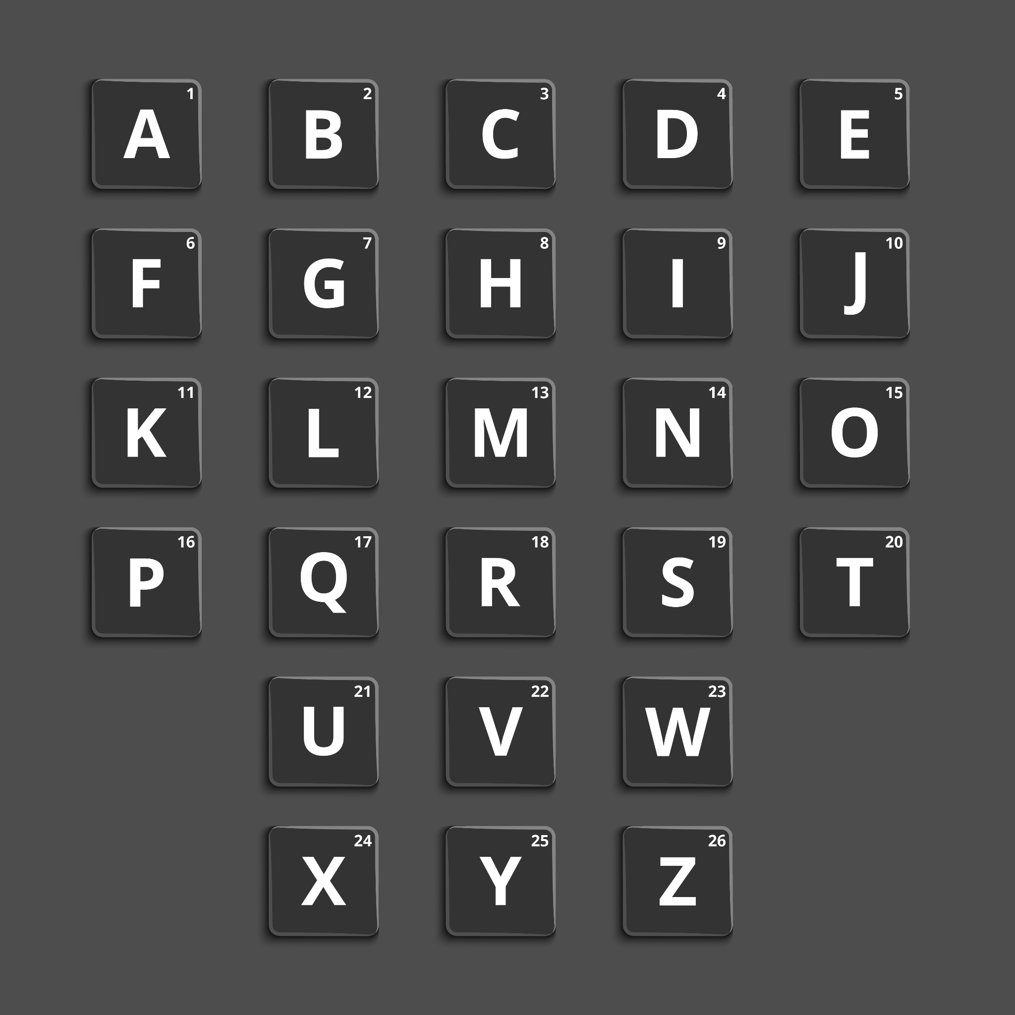
Ciphers
Substitution Ciphers
Method of encryption where each character in a message is being replaced with different characters.
Caesar Cipher
Simple encryption technique
Shifts letters in a message by a
fixed number of positions in the
alphabet.
Notes:
Mention moderators and Questions tab. Our agenda includes an introduction to CoGrammar, details about student success support, graduation criteria, guided learning hours, learning tools and platforms, an overview of the Skills Bootcamp, and career services.

Slide 13

Ciphers
Symmetric vs Asymmetric Encryption
Symmetric encryption
Uses a single key for both encryption and decryption.
Asymmetric encryption
Uses two keys for encryption and decryption.
Private and Public key.
Notes:
Mention moderators and Questions tab. Our agenda includes an introduction to CoGrammar, details about student success support, graduation criteria, guided learning hours, learning tools and platforms, an overview of the Skills Bootcamp, and career services.

Slide 14
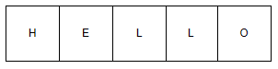
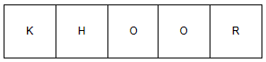
Caesar Cipher
Substituting each letter in plaintext with a letter a fixed number of positions down the alphabet.
Shift = 3
Notes:
Mention moderators and Questions tab. Our agenda includes an introduction to CoGrammar, details about student success support, graduation criteria, guided learning hours, learning tools and platforms, an overview of the Skills Bootcamp, and career services.

Slide 15
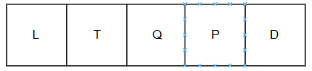
Vigenere Cipher
Method for encrypting alphabetic text that uses a keyword to encode each letter of the plaintext with a different Caesar cipher
Key = DOG
Notes:
Mention moderators and Questions tab. Our agenda includes an introduction to CoGrammar, details about student success support, graduation criteria, guided learning hours, learning tools and platforms, an overview of the Skills Bootcamp, and career services.

Slide 16
Polls
Please have a look at the poll notification and select an option.
What is a cipher?
A type of algorithm for encrypting and decrypting information
A programming language for security
A physical lock mechanism
A mathematical formula for compression
Notes:
Mention moderators and Questions tab. Our agenda includes an introduction to CoGrammar, details about student success support, graduation criteria, guided learning hours, learning tools and platforms, an overview of the Skills Bootcamp, and career services.

Slide 17
Polls
Please have a look at the poll notification and select an option.
What does a Caesar Cipher do?
Reverses the text
Shifts each letter by a fixed number of places
Converts text into binary
Randomises letters with no pattern
Notes:
Mention moderators and Questions tab. Our agenda includes an introduction to CoGrammar, details about student success support, graduation criteria, guided learning hours, learning tools and platforms, an overview of the Skills Bootcamp, and career services.

Slide 18

Recap
We use ciphers to encrypt and decrypt sensitive data
Caesar cipher shift character by a given number of position in the alphabet.
Notes:
Mention moderators and Questions tab. Our agenda includes an introduction to CoGrammar, details about student success support, graduation criteria, guided learning hours, learning tools and platforms, an overview of the Skills Bootcamp, and career services.

Slide 19
Questions and
Answers

Slide 20

Thank you for attending

